Slide 1
A Graph-Based PSO Approach to QoS-Aware Web Service Composition and Selection
Alexandre Sawczuk da Silva, Hui Ma, Mengjie Zhang
School of Engineering and Computer Science
Victoria University of Wellington, New Zealand
Notes:
Good afternoon everyone, my name is Alex da Silva and today I am going to tell you about our work on Web Service composition using an artificial intelligence technique called particle swarm optimisation.

Slide 2
Introduction
Notes:
Let’s begin by understanding what a Web service is.

Slide 3
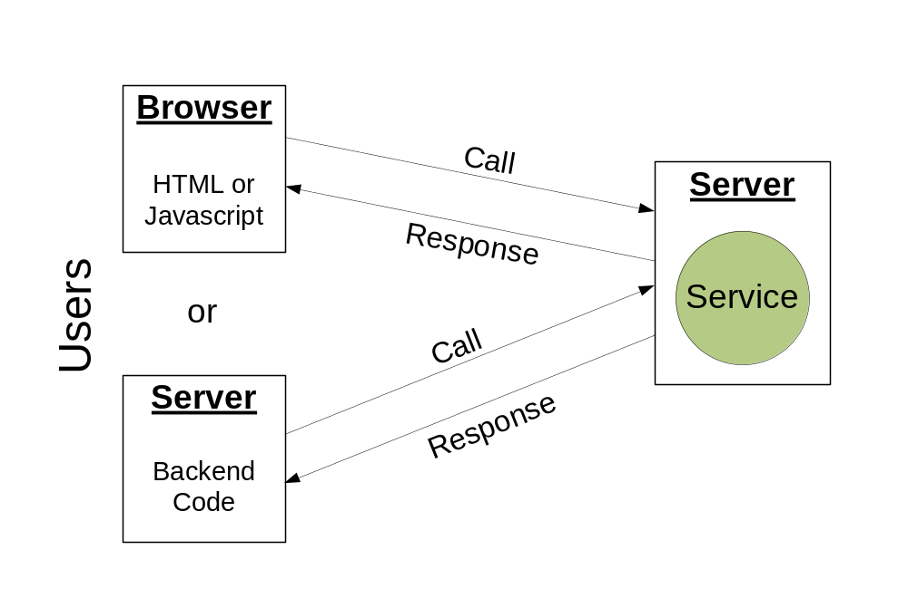
Web Services
Notes:
Web services are modular applications that offer some piece of functionality and are accessible over the network. For example, some Web services perform currency conversions, or provide weather information.
Web services are used either by a human who accesses its functionality through a web page, or by a server. In both cases, the user sends a request to the service, that is running on another server, and receives a response in return.

Slide 4
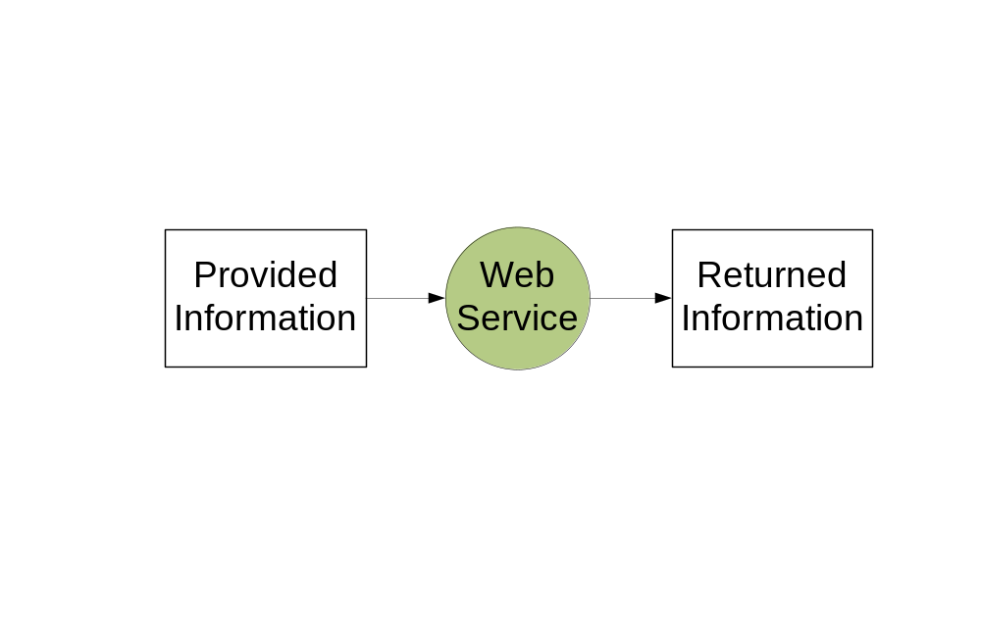
Typical Usage
Notes:
Web services are typically used in the following way: the user provides some information, and this information is either processed by the Web service and returned in a different format or is used to retrieve additional information that is then returned.

Slide 5
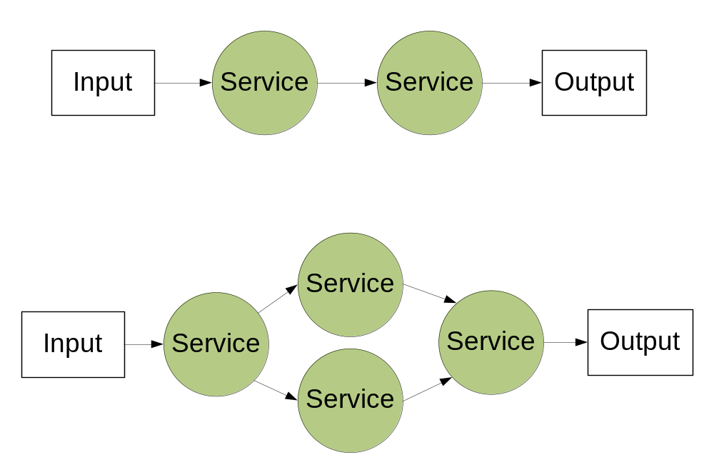
Service Composition
Notes:
The basic functionality of several Web services can be combined into a composition that accomplishes more complex tasks. In the scope of this project we consider compositions that use two patterns: sequential combinations of Web services, where services are to be executed one after the other, and parallel combinations, where services are to be executed simultaneously.

Slide 6
Composition Determination
Manual
Automated ✓
Notes:
At first Web service compositions were created manually, but over time researchers started to employ techniques for creating them automatically.
Because deterministic algorithms take too long to consider all the possible combinations for service composition, researchers turned to the evolutionary computation approach. These provide solutions in a reasonable amount of time. In EC, compositions are evolved through several generations using a fitness function to differentiate the good candidates from the not-so-good ones.
But there are several different techniques to choose from within the field of EC. For the problem of composition, other works have already shown that using a swarm of particles to search for the solution is more efficient time-wise than evolving trees of solutions, for example. Because of that, in this work we decided to further investigate the use of particle swarm optimisation (PSO).

Slide 7
An Example
Notes:
Let us have a look at an example of a general composition problem.

Slide 8
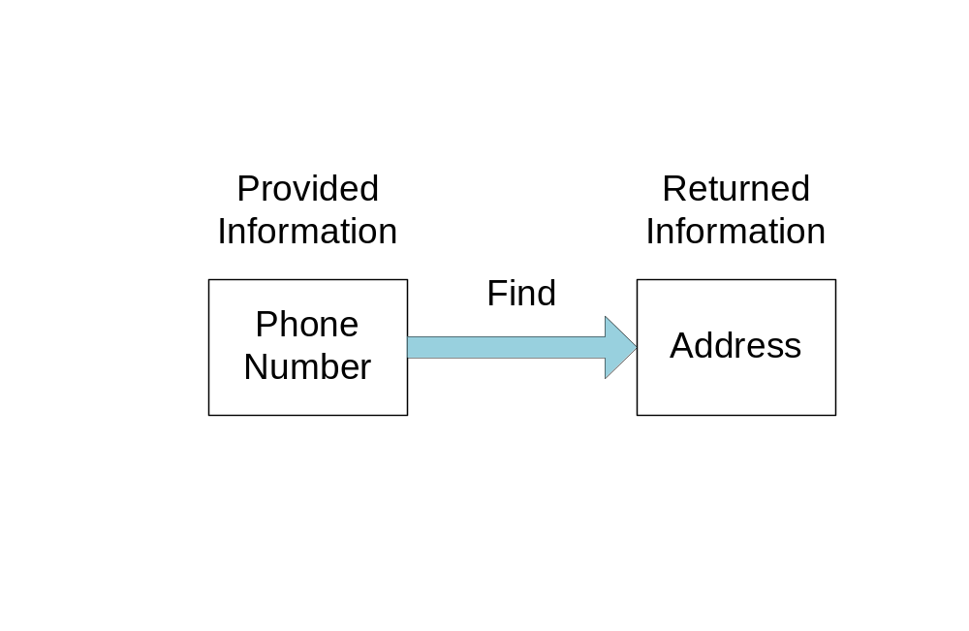
Example
Notes:
Suppose the task is to discover the address associated with a phone number.

Slide 9
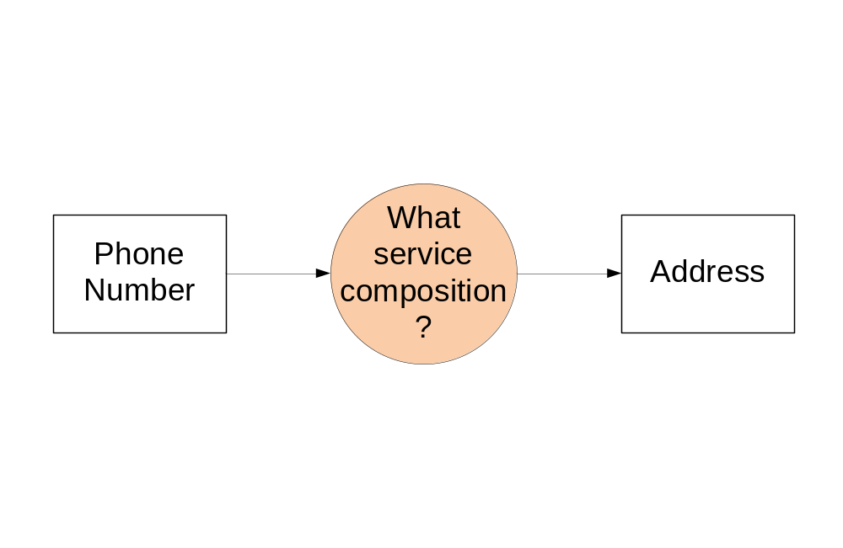
Goal
Notes:
In this case, we know the kind of input and the kind of output that we have, but we must discover what composition could return what we want based on what we know.

Slide 10
Solution
Notes:
To solve the problem, we begin by looking through the services that we have available.

Slide 11
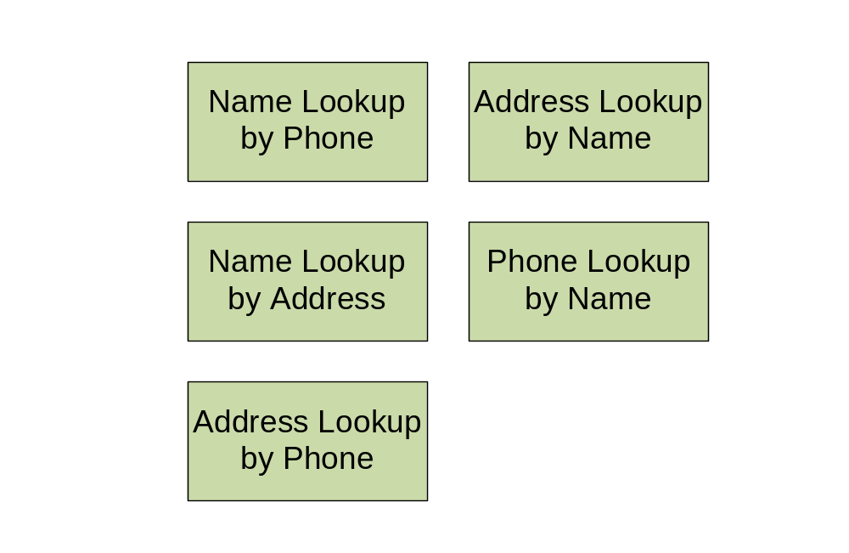
Available Services
Notes:
We see that there are several different functionality modules that we could use. We could look up a phone number based on a name, or look up a name based on an address and so on.

Slide 12
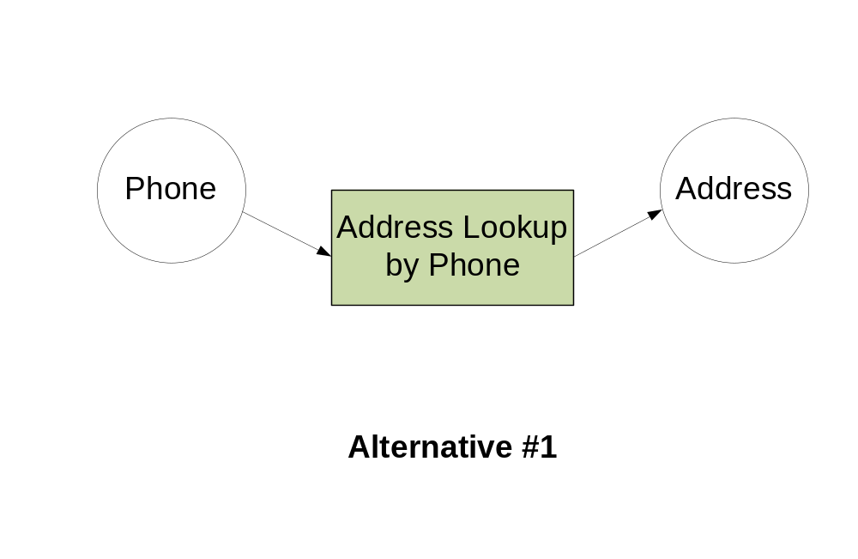
Obvious Alternative
Notes:
An obvious solution would be to use the service that takes a phone number and returns an address directly. One functionality module, simple.

Slide 13
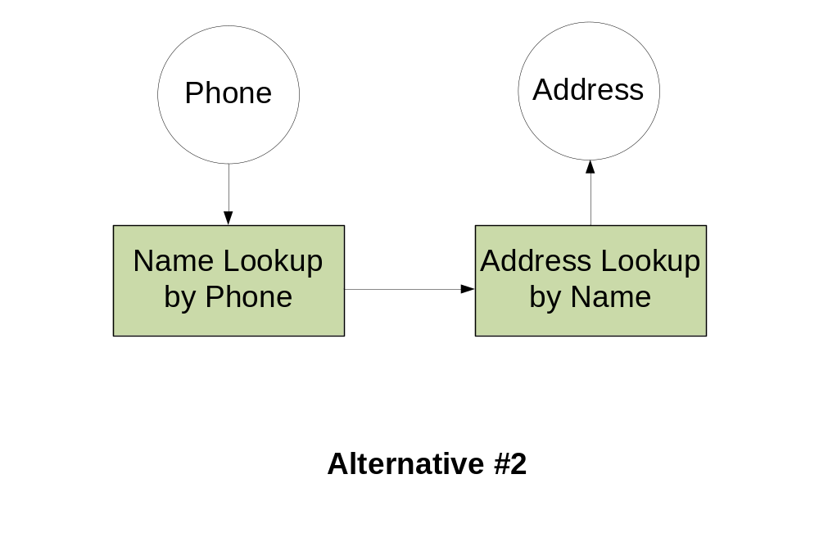
Other Alternative
Notes:
But we notice that there is also another solution, which involves using two services. The first one finds a name based on the phone number, then using that name we find the address.

Slide 14
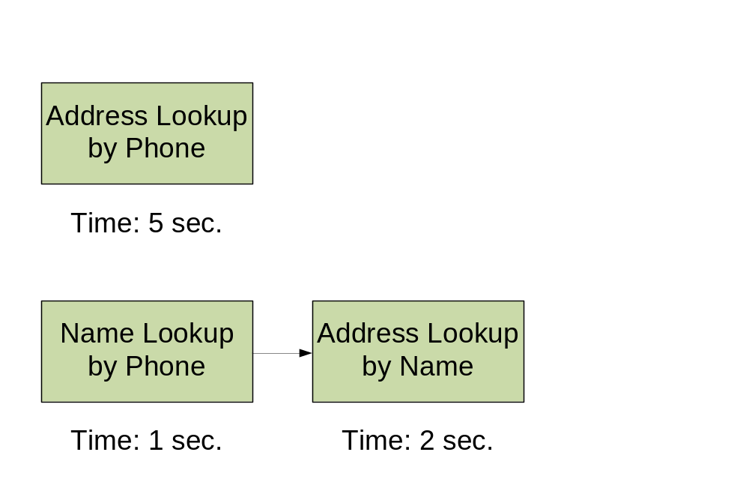
Which is Best?
QoS Factors
  Availability
  Time
  Cost
  Reliability
Notes:
How do we determine which solution is best? We do so by looking at the quality of service factors of each Web service. QoS factors are measures of different characteristics of a service, such as the amount of time they take to run and how reliable they are.
In our example, we see that the solution with two Web services takes only three seconds to execute while the solution with one service takes five seconds. You might wonder why two services would take less time than a single service. This could be due to network latency or the speed of the servers themselves.
Of course, when using a composition technique we take all QoS factors into account.

Slide 15
The Traditional Approach
Notes:
Now that we have understood the intuition of QoS-aware Web service composition, let us understand how the current methods that use Particle Swarm Optimisation approach the problem.

Slide 16
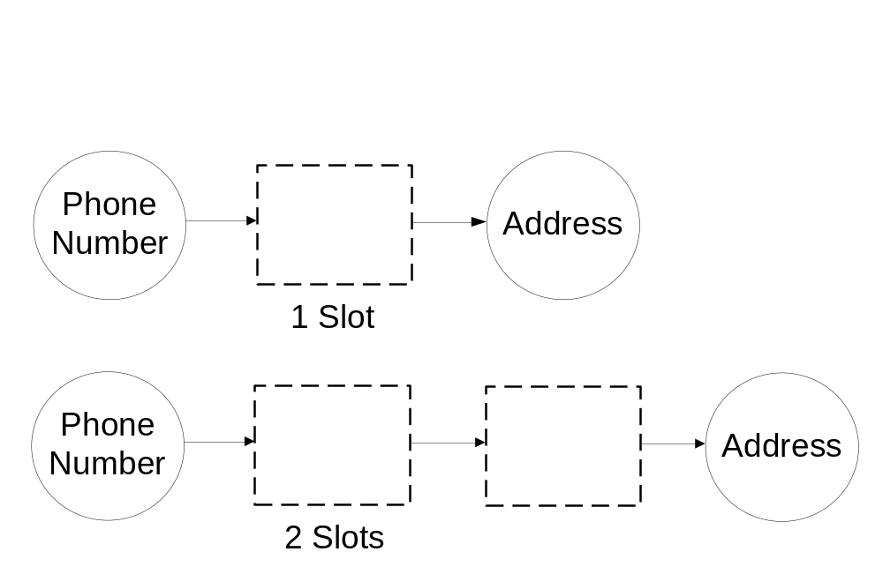
Traditional PSO Approach
Pre-choose abstract workflow
Notes:
Before starting the optimisation process, the traditional approach requires that we choose an abstract workflow to be optimised. We can think of this workflow as a template where we try to fit concrete services. We could have workflows with 1, 2, or more slots.
Existing literature on PSO assumes that someone with domain expertise has already chosen the appropriate abstract workflow, or that it has been somehow retrieved from a repository. However, within the current literature no further explanation is offered on how to actually do it.

Slide 17
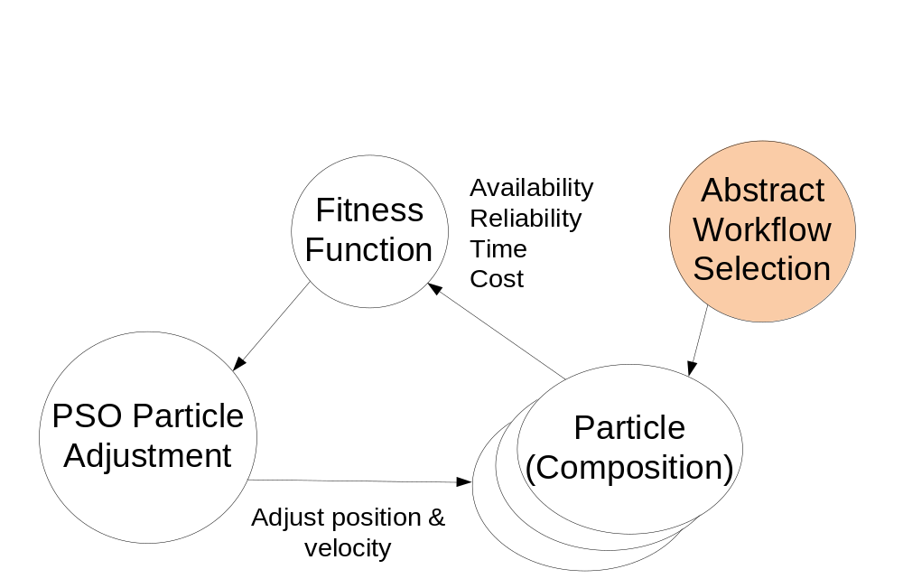
Greedy-Based PSO Implementation
(Traditional)
Notes:
Because there is no such explanation, we began by proposing an implementation of the traditional PSO approach called Greedy-based PSO. In the diagram, the white bubbles are standard PSO and the coloured bubble is what we have added. In this implementation, we performed automated selection of an abstract workflow by using a greedy algorithm, as indicated by the coloured bubble on the upper-right corner.
This algorithm generates several possible abstract workflows looking at the available services. It then selects the abstract workflow with the least number of slots, under the assumption that this will translate into a composition with better overall quality of service. So in our particular example, the algorithm would always select the abstract workflow with one slot over the one with two (even though it takes more time).
Having selected the abstract framework, the PSO algorithm is then run. Each particle, shown in the bottom right corner, represents a different solution that contains a combination of services to fill the slots of the workflow. We evaluate the goodness of each proposed solution using a fitness function, as shown in the diagram, that is based on a combination of QoS factors. After determining the best particle, we adjust all particles according to it, so that they are looking for similar solutions that might be better.
This search process is run for a certain number of iterations (generations), and the best solution found during the course of the entire search is chosen as the final composition.

Slide 18
The New Approach
Notes:
After implementing the traditional approach, we went on to implement a better version of PSO for Web service composition.

Slide 19
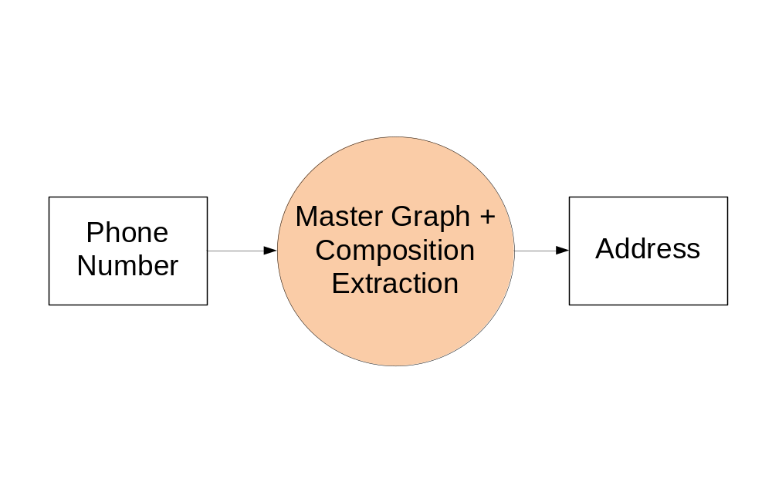
New Approach
No abstract workflows
Notes:
Our version does not rely on the pre-selection of an abstract workflow for optimisation. Instead, it determines the workflow to be used in the composition at the same time it selects the services that should be in it.
To achieve that, two main ideas were introduced. The first idea is that of a Master Graph. The Master Graph is a graph that shows all of the relationships between the output of a service and the input of other services. For example, a service that outputs an address may be combined with any services that take an address as input. These links are made for all possible combinations given a set of services.
The second idea is that of the composition extraction algorithm. This algorithm is capable of extracting functional sub-graphs of services from within the master graph according to some criteria.

Slide 20
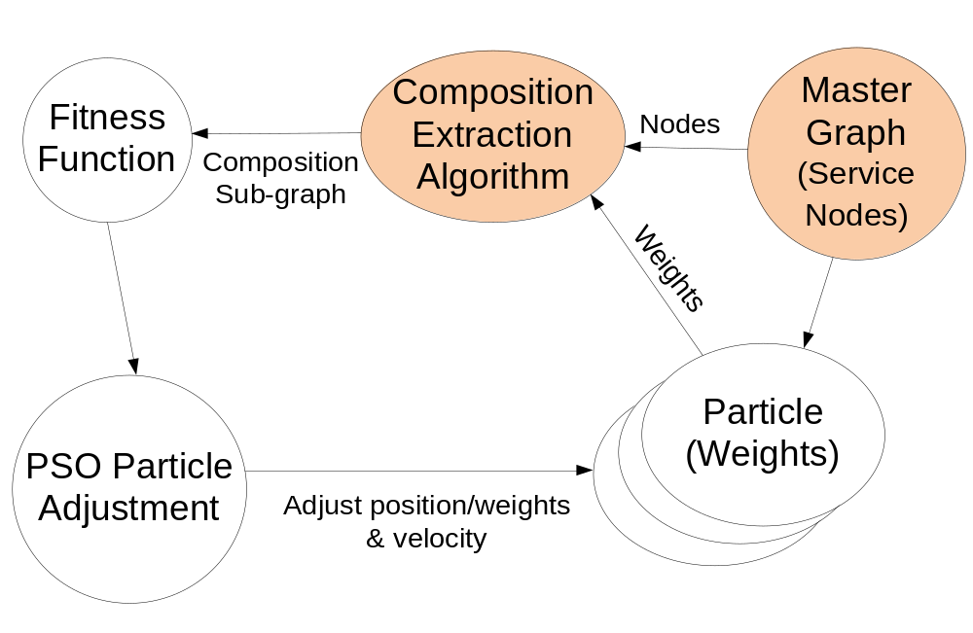
Graph-Based PSO
Notes:
Our novel implementation is called graph-based PSO, because it relies on the master graph for performing the composition. Here we see again that the coloured bubbles are the novel steps, and the white bubbles are the standard PSO algorithm.
The first step is the creation of the master graph, as we have discussed. This time each particle in the swarm this time stores a set of weights, each weight corresponding to an edge of the master graph.
The PSO algorithm is then run. A composition sub-graph is extracted from the master graph for each particle, using the weights in the particles as the criteria for running the composition extraction algorithm. Once the candidate composition has been retrieved, the fitness function is used to discover the best particle. The weights of all particles is adjusted according to best particle, and the process repeats for several iterations as we explained before.
Notice that this time the particle does not directly represent a solution.

Slide 21
Experiment
Notes:
We conducted an experiment comparing our implementations of the traditional and novel approaches.

Slide 22
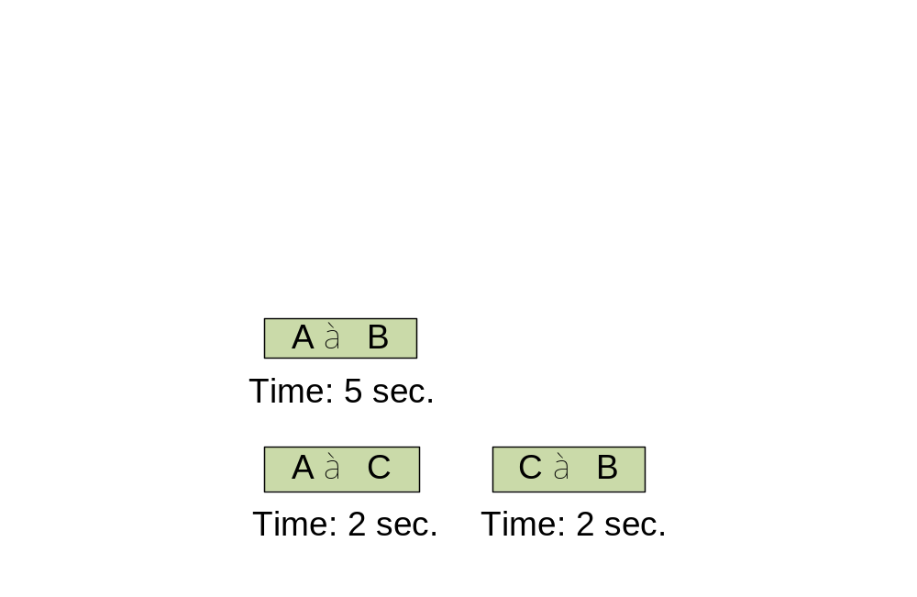
Test Datasets
Based on QWS dataset
For every single service
  Added multi-service alternative with higher QoS:
Notes:
For this experiment we generated 5 datasets. They were based on QWS, an existing dataset that contains Quality of Service measurements.
For each single service from the original dataset, we added a multi-service alternative that offered better quality of service.
For example, for a service with input A and output B that takes 5 seconds to execute, we added a two services, one from A to C and the other from C to B, that take less time to execute overall. This was done to highlight the scenario where a larger composition is actually more efficient.

Slide 23
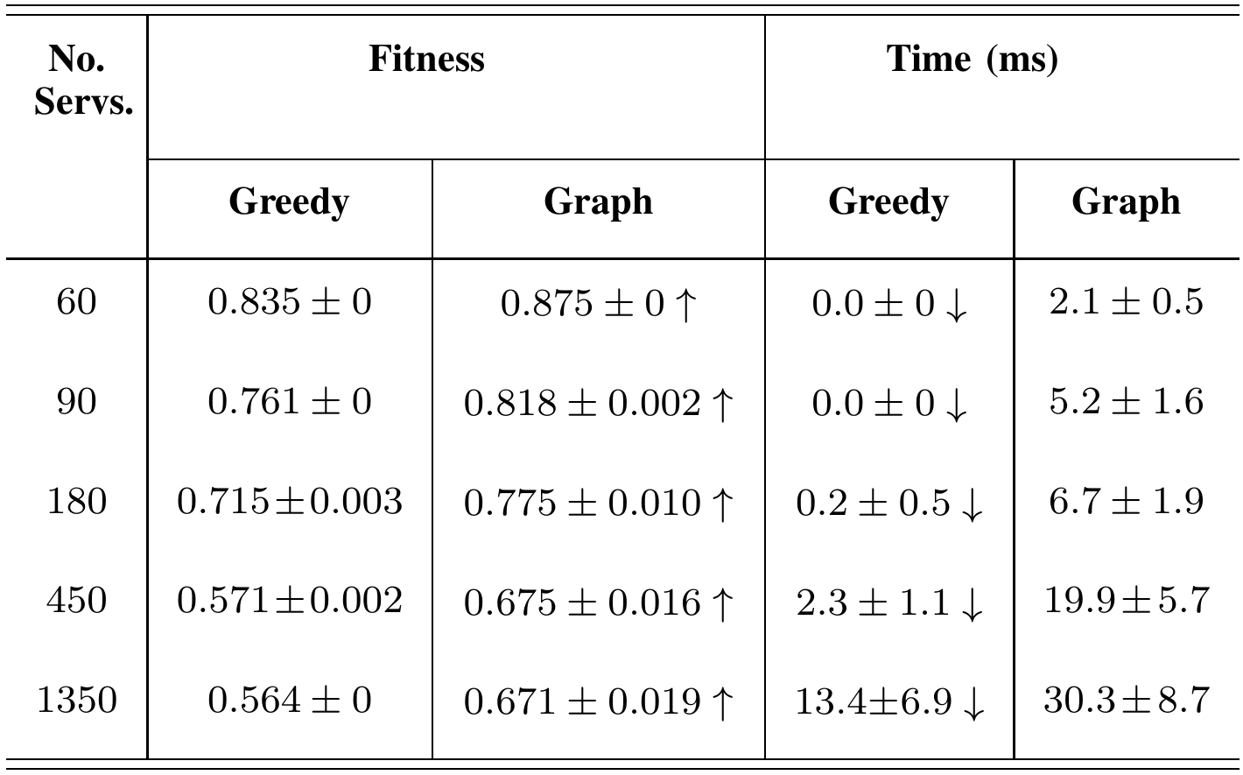
Results
Notes:
Results of the experiments using the datasets show that the novel graph-based approach was capable of finding significantly better solutions in all cases, but the traditional greedy-based approach had significantly better execution times for all datasets.

Slide 24
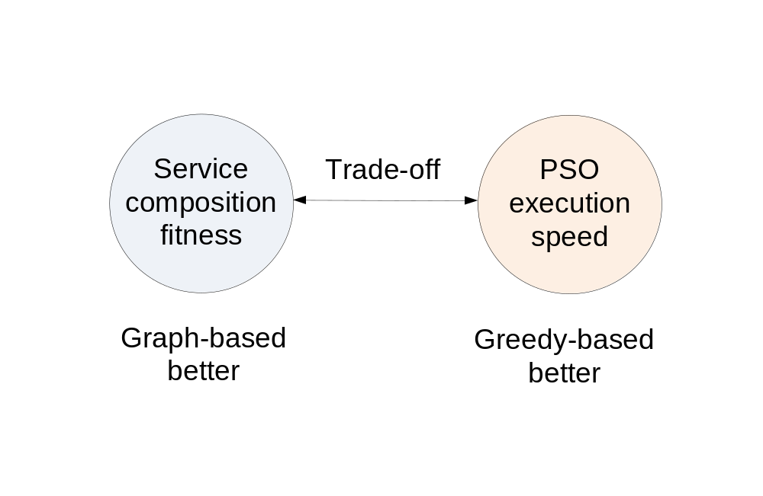
Discussion
Notes:
These results show that there is a trade-off between using the traditional and novel approaches:
The novel graph-based approach is preferred when we want a solution with the best possible fitness, even if execution time is not the best.
The traditional greedy-based approach, on the other hand, is better when execution speed of the algorithm is more important than the quality of the final result.

Slide 25
Summary
Introduced Graph-based PSO
Novel feature: no abstract workflow pre-selection
Higher fitness than traditional
Future work:
  Comparison with other techniques
  Include loops and branching
Notes:
In summary, this work introduced a new graph-based approach for using particle swarm optimisation for Web service composition.
This approach has the novelty of not requiring the pre-selection of a workflow for optimisation, and instead it figures out the best workflow as the algorithm runs.
The experiments showed that this approach can lead to solutions with higher fitness, even if the execution time is not as fast as the traditional approach.
Future work possibilities include the comparison of the novel approach with other evolutionary computation techniques, and also the expansion of the graph representation for the composition to take into account loop and conditional branching constructs.

Slide 26
Questions
Thank you!
Notes:
Thank you for listening! Are there any questions?

